Slide 1
Kerberos in Active Directory Environment
Andrea Artioli, MVTINAPWN
andrea.artioli@unimore.it

Slide 2
Index
AD concepts overview
Kerberos overview
Kerberos basic interaction
KDF
Basic real word attacks on Kerberos
NTLM authentication
Delegation attacks
  Unconstrained
  Constrained [Coming soon]
  Resource-Based Constrained [Coming soon]

Slide 3
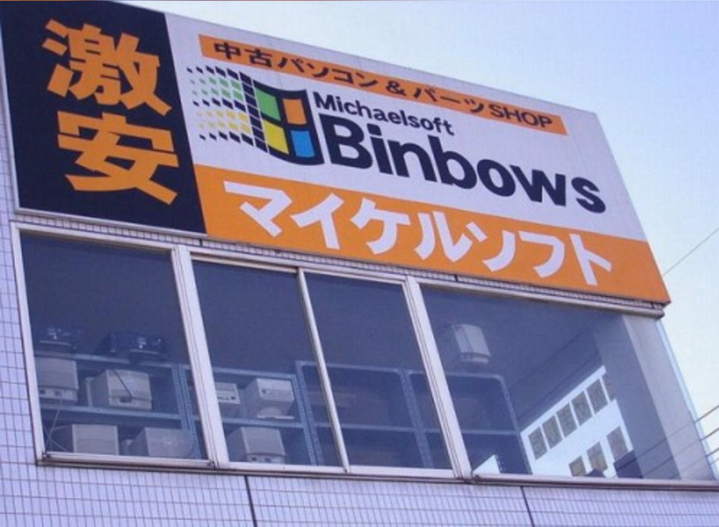
Disclaimer
I am NOT a professional PT/Red teamer
  I just studied this stuff and I think they are interesting, but 0 real experience
Correct me if I’m wrong!
  I am here to learn, not to flex
Ask anything at anytime!
  I love questions and stupid jokes

Slide 4
AD concepts
Centralized control of a Windows Network
Domain Controller (Windows Server)
LDAP, MSRPC, Kerberos, NTLM
User, Groups, Machine, Shares management
Service management (Service Principal Name)

Slide 5
Kerberos Overview
Authentication protocol
Centralized
  AS (Authentication Service)
  TGS service (Ticket Granting Service, a.k.a. KDC)
Tickets
  TGT (Ticket Granting Tickets)
  TGS (Ticket Granting Service)
No assertions of: OS, address, physical security

Slide 6
Kerberos Overview
Based on symmetric cryptography
  Assumption of shared secret (User/KDC/AS)
  Attackers cannot bruteforce passwords
Resilient to adaptive attackers
  “packets traveling along the network can be read, modified, and inserted at will“
Stateless
  AD implementation provides Authentication and Authorization (Privilege Attribute Certificate)
  Weak post-compromise strategy
Notes:
Dolev-Yao

Slide 7



KDC + AS (DC)
USER
SERVICE PRINCIPAL
AS-REQ
Note:
May contain a salt for KDF
KDC should maintain a cache within an acceptable time range (clock skew)
user@domain
Authenticator
Authenticator

Slide 8


KDC + AS (DC)
USER
SERVICE PRINCIPAL
AS-REP
Note:
TGT cannot be tampered by user
Privilege Attribute Certificate (PAC): contains user information
Client-Service Key
TGT ( PAC + Client-DC Key)

Slide 9
KDC + AS (DC)
USER
SERVICE PRINCIPAL
TGS-REQ
Note:
Used for inter-relam TGT
Authenticator cache
Authenticator
TGT(Session Key + PAC)
SPN

Slide 10


KDC + AS (DC)
USER
SERVICE PRINCIPAL
TGS-REP
Note:
Identical to AS-REP but with user-KDC session key
TGS cannot last more than its TGT -> cascade attack
Client-Service Key
TGS ( PAC + Client-Service Key)

Slide 11
KDC + AS (DC)
USER
SERVICE PRINCIPAL
AP-REQ
Note:
TGS != Authentication
Authenticator cache
Subkey field in the authenticator message
PAC validation?
Authenticator
TGS ( PAC + Client-Service Key)

Slide 12
KDC + AS (DC)
USER
SERVICE PRINCIPAL
AP-REP
Note:
Only if mutual auth required
CT must be different
Authenticator

Slide 13
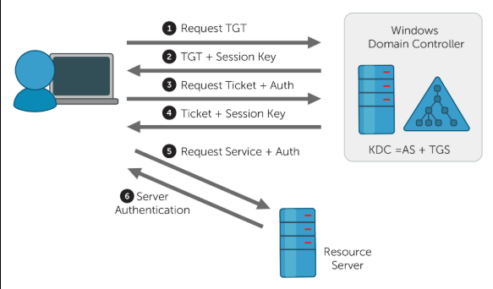
Recap

Slide 14
Unencrypted Part:
Version number of ticket format.
Service realm
Service principal
Encrypted Part:
Ticket flags*
Session key
Client realm
Client principal (username)
List of Kerberos realms that took part in authenticating the user to whom this ticket was issued.
Timestamp and other meta data about last initial request.
Time client was authenticated.
Validity period start time (optional).
Validity period end time.
Ticket Granting Server (TGS) Name/ID
Timestamp
Client (workstation) Address
Lifetime
Authorization-data

Slide 15
KDF: RC4-HMAC-MD5 (etype 23)
Cipher key:
  key_d = MD4(UTF-16LE(password))
MAC:
  key_i = hmac_md5(key_d, salt)
  TAG = hmac_md5(key_i, data)

Slide 16
KDF: AES128/256-CTS-HMAC-SHA1-96 (etype 17/18)
Cipher key:
  tkey = random2key(PBKDF2(password, salt, iter_count, keylength))
  key_d = DK(tkey, "kerberos")
MAC (form here):
  key_i = DK(key_d, hex2byte("62dc6e371a63a80958ac562b15404ac5"))
  TAG = hmac_sha1(key_i, data)

Slide 17
Real world techniques
Username enumeration
  The AS-REQ returns different messages if username exists or not. It can be used to enumerate possible usernames.
  From linux:
    kerbrute userenum
  From Windows:
    .\kerbrute.exe userenum
  Logged with specific Kerberos logs that are not enabled by default (Event ID 4768)

Slide 18
Real world techniques
Password spraying
  Try to log-in using a common password over a list of usernames.
  From linux:
    kerbrute passwordspray
  From Windows:
    .\kerbrute.exe passwordspray
    .\DomainPasswordSpray.ps1
  Failed login attempts over a short period are logged by default (Event ID 4625) and, if kerberos log is activated, pre-authentication failed (Event ID 4771)

Slide 19
Real world techniques
AS-REP Roasting
  If no pre-authentication required, then it is possible to brute force the AS-REP given a valid username and obtain its password. It is possible to do the same if an AS-REP is intercepted.
  From linux (impacket):
    GetNPUsers.py [-request]
  From Windows:
    .\Rubeus.exe asreproast
  Cracking:
    hashcat -m 18200
    john
  Logged with Kerberos logs that are not enabled
  by default (Event ID 4768 with preauth set to 0)
  and honeypot
AS-REP
Session Key
TGT(Session Key + PAC)

Slide 20
Real world techniques
Kerberoasting
  If you have an authenticated account you can request a TGS and crack it just like an AS-REP
  From linux (impacket):
    GetUserSPNs.py [-request]
  From Windows:
    .\Rubeus.exe kerberoast
  Cracking:
    hashcat -m 13100
    john
  Logged with Kerberos logs that are not enabled
  by default (many Event ID 4769 from the same
  user + RC4 tickets) and honeypot
TGS-REP
Client-Service Key
TGS ( PAC + Client-Service Key)

Slide 21
Real world techniques
Golden/Silver tickets
  If krbtgt account is compromised, you can forge TGT/TGS tickets, obtain keys of any user and tamper the PAC inside the tickets.
  From linux (impacket):
    ticketer.py
  From Windows:
    .\mimikatz.exe kerberos::golden
  Harder to detect: RC4 ticket when AES is the norm, missing fields in tickets, invented usernames, strange interaction of sensible processes

Slide 22
Real world techniques
MS14-068
  Implementation flaw patched in november 2014. Allows forged PAC to be accepted: if PAC dimension was <= 20 bytes, non keyed tag was accepted. Automatic domain takeover from standard authenticated user.
  From linux:
    goldenPac.py (impacket)
    PyKEK
  From Windows:
    PyKEK (requires python3) + mimikatz

Slide 23
NTLM authentication
Alternative authentication protocols in AD environment
Challenge-response protocol
NTLM authentication protocols (v1, v2)
DC as trusted third party
NTHash, LMHash

Slide 24
LMHash (hashcat -m 3000)
The user’s password is converted to uppercase.
The user's password is encoded in the System OEM code page.
This password is NULL-padded to 14 bytes.
Password is split into two 7-byte halves.
These two values are used to create two DES keys, inserting a parity bit after every seven bits. This generates the 64 bits needed for a single DES key.
Each of the two keys is used to DES-encrypt the constant ASCII string “KGS!@#$%”, resulting in two 8-byte ciphertext values.
These two ciphertext values are concatenated to form a 16-byte value, which is the LM hash.

Slide 25
NTHash (hashcat -m 1000)
MD4(UTF-16LE(password))
Same as kerberos rc4 key!

Slide 26
NTLM protocol concepts 1
Client contacts server sending username@domain
Server sends C random server challenge
Client solves the challenge and sends back the response
Server forwards the response to the DC that verifies it
DC replies with the result of the verification

Slide 27
Exchanges
NTLMv1
  C = 8-byte server challenge, random
  K1 | K2 | K3 = LM/NT-hash | 5-bytes-0
  response = DES(K1,C) | DES(K2,C) | DES(K3,C)
NTLMv2
  SC = 8-byte server challenge, random
  CC = 8-byte client challenge, random
  CC* = (X, time, CC2, domain name)
  v2-Hash = HMAC-MD5(NT-Hash, user name, domain name)
  LMv2 = HMAC-MD5(v2-Hash, SC, CC)
  NTv2 = HMAC-MD5(v2-Hash, SC, CC*)
  response = LMv2 | CC | NTv2 | CC*

Slide 28
NTLM protocol concepts 2
The only information needed to solve the challenge is the NT/LM hash of the password, NOT THE CLEARTEX PASSWORD ITSELF
  Pass-the-hash
Brute Force
No mutual authentication with the server
  LLMNR/NBT-NS Poisoning (+ Cracking / + Relay attack)

Slide 29
Unconstrained delegation
A service that can impersonate every authenticated user with every possible service in the domain.
The final service is accessed within the user context, not the service context
  Better privilege model(?)
From now on, I “cite” ATTL4S’ slides because I was tired to do them on my own :)

Slide 30
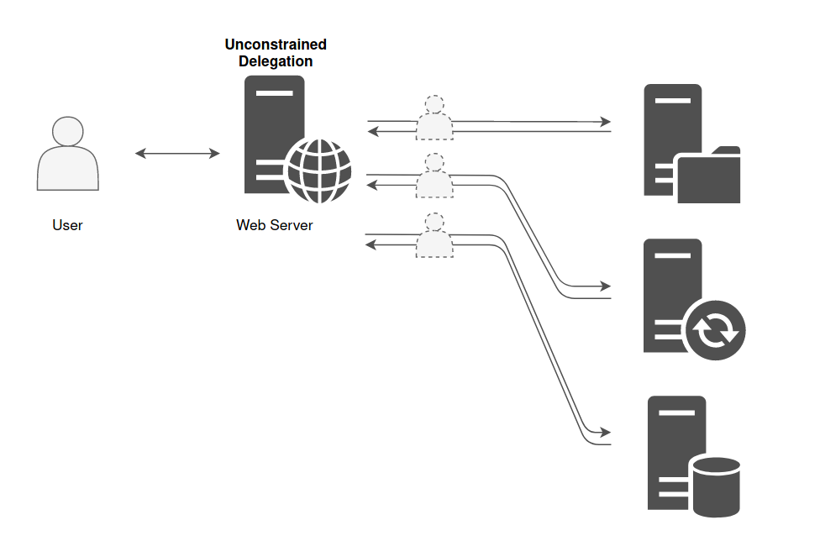
Unconstrained delegation

Slide 31
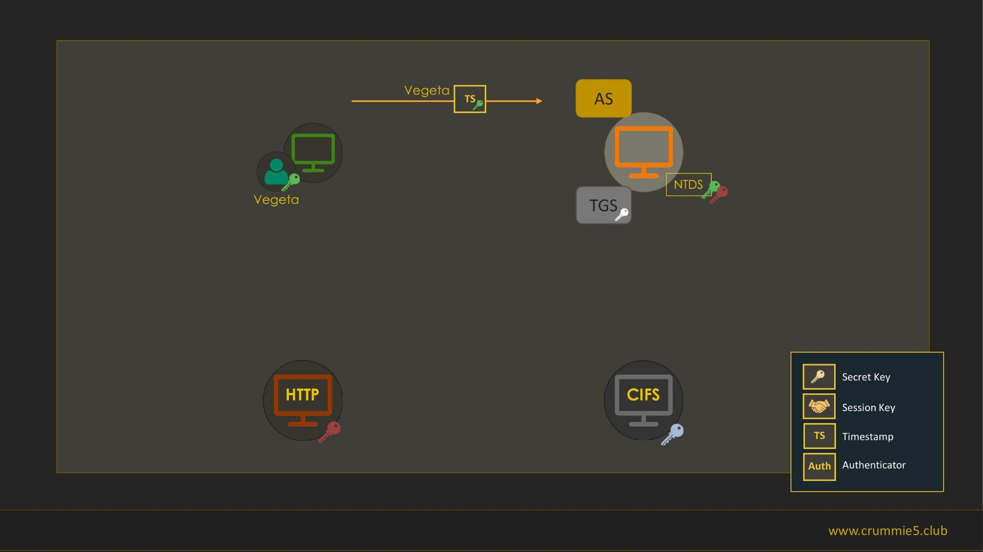

Slide 32
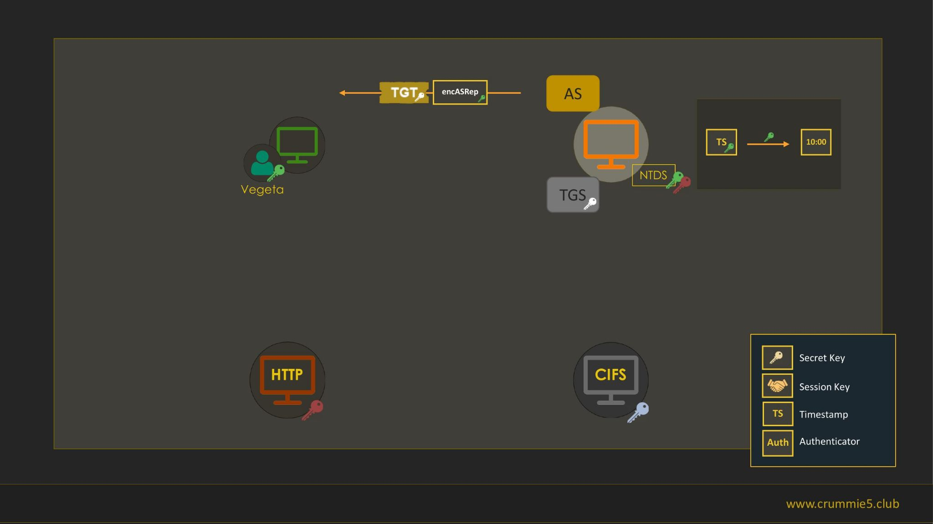

Slide 33
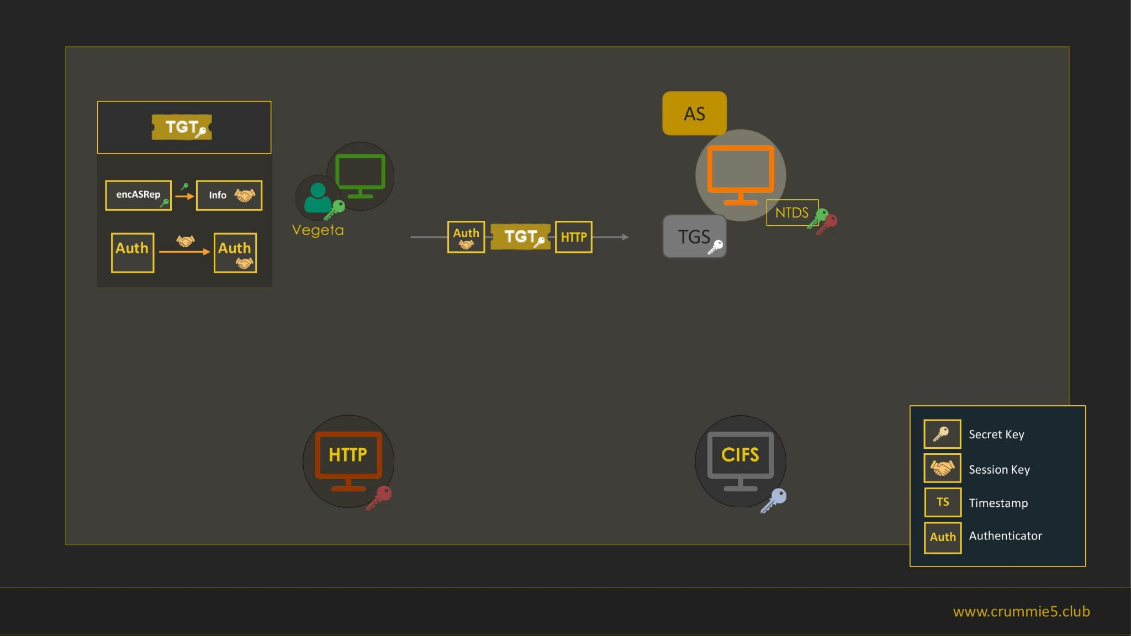

Slide 34
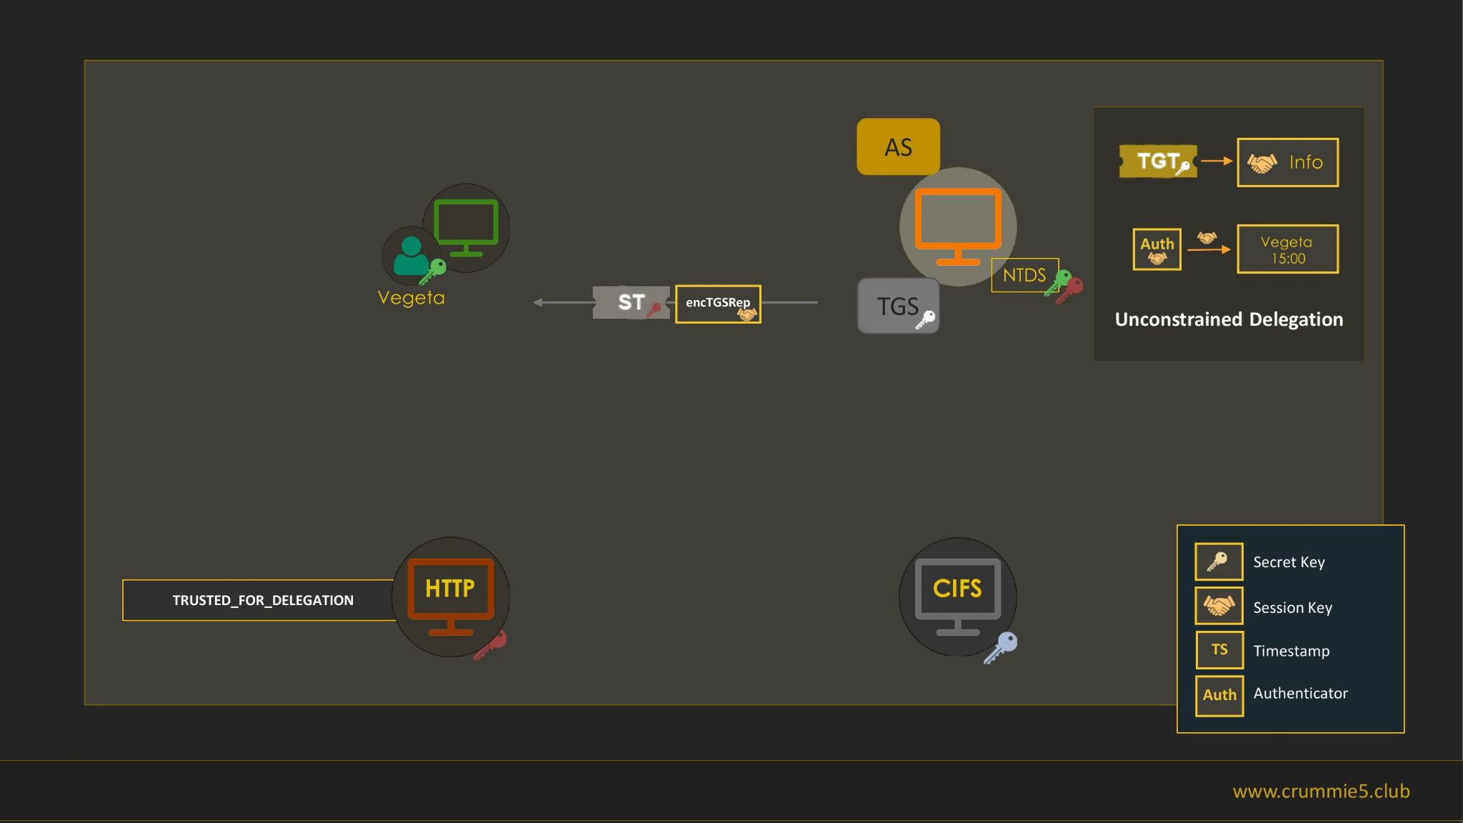

Slide 35
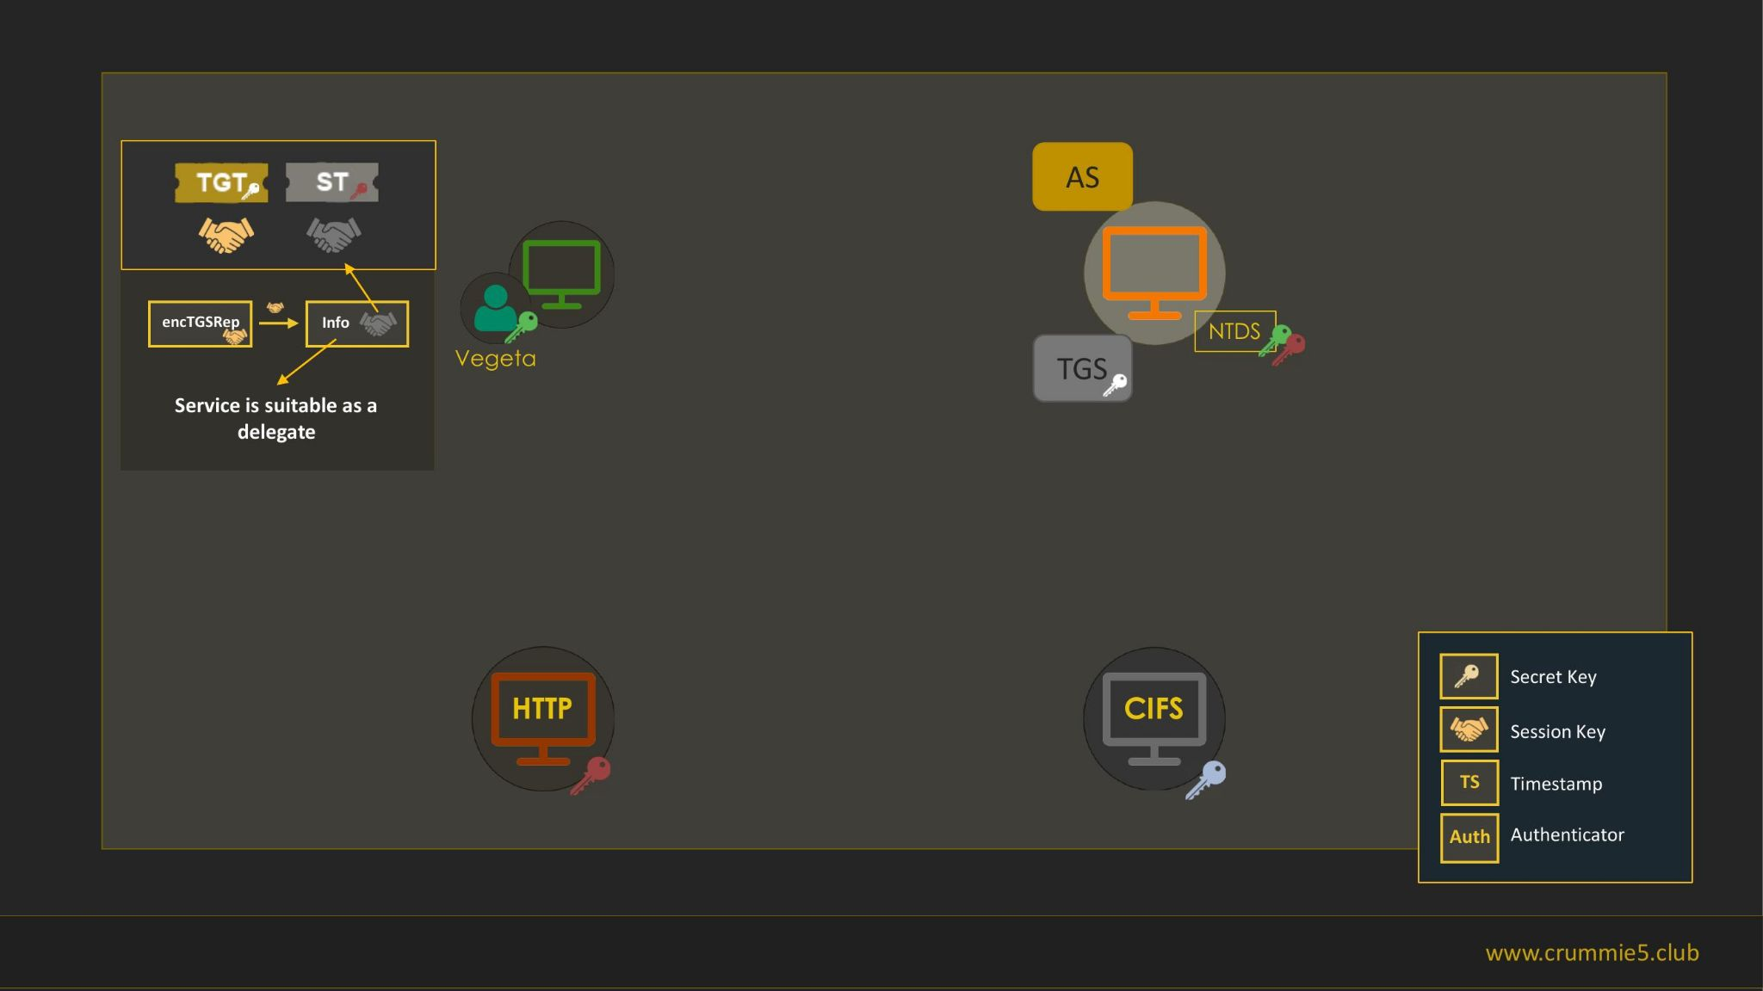

Slide 36
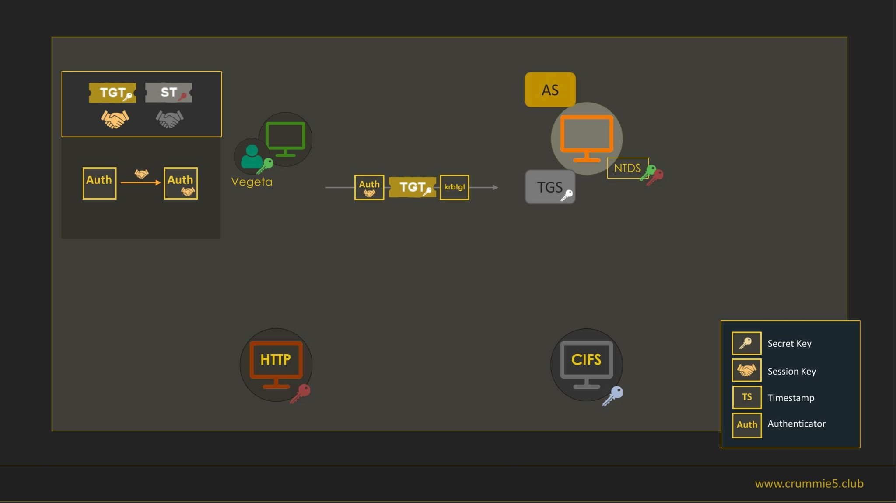

Slide 37
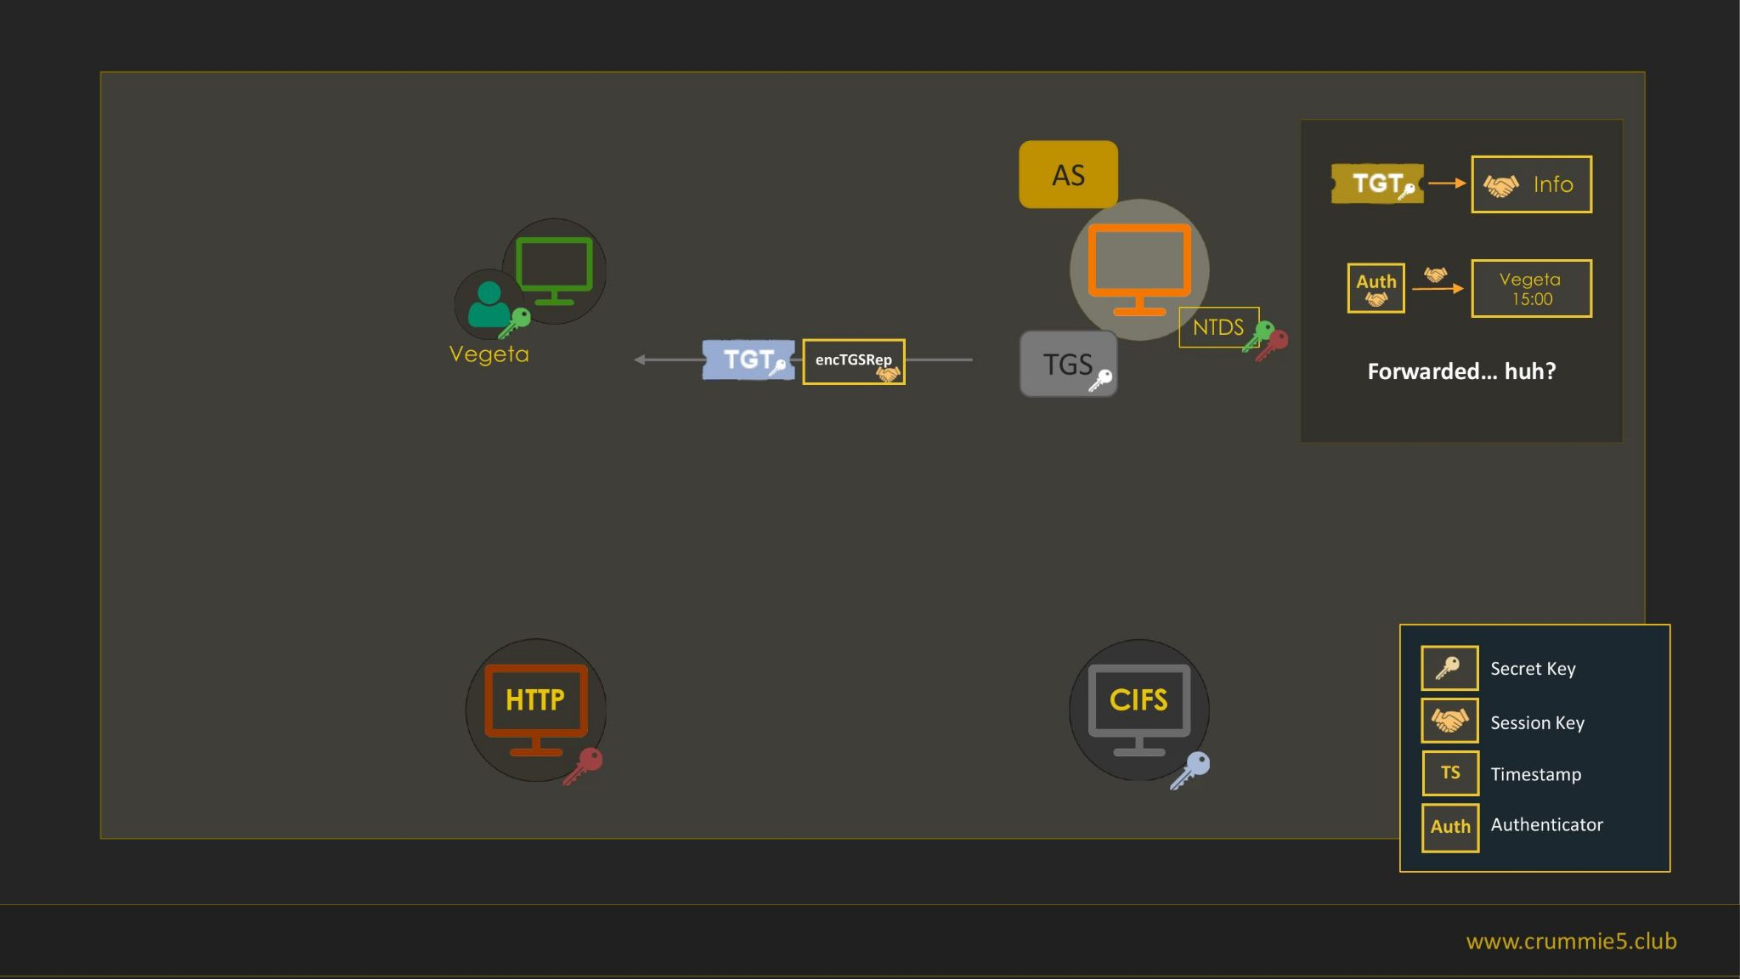

Slide 38
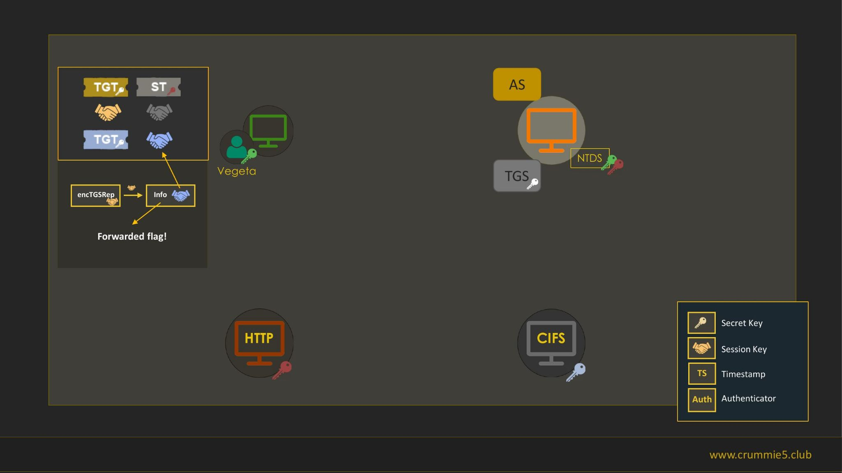

Slide 39
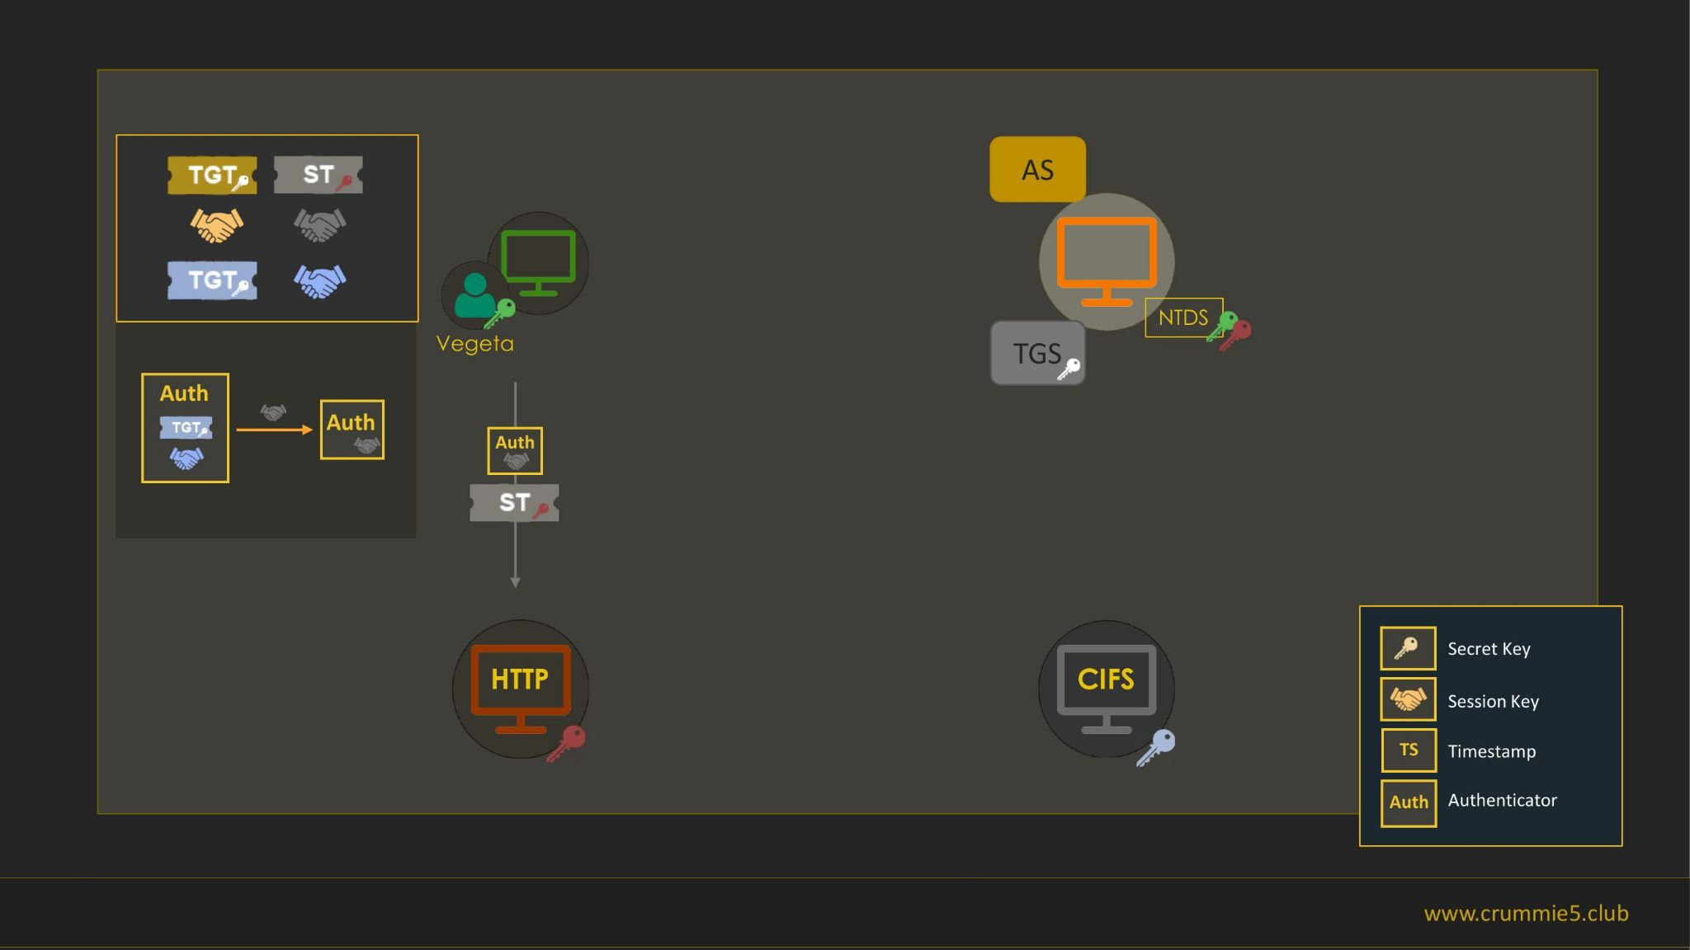

Slide 40
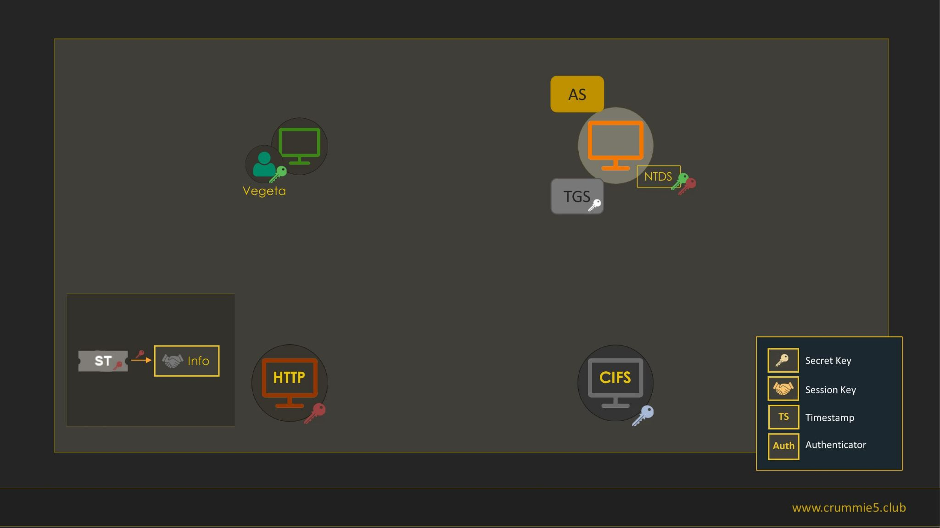

Slide 41
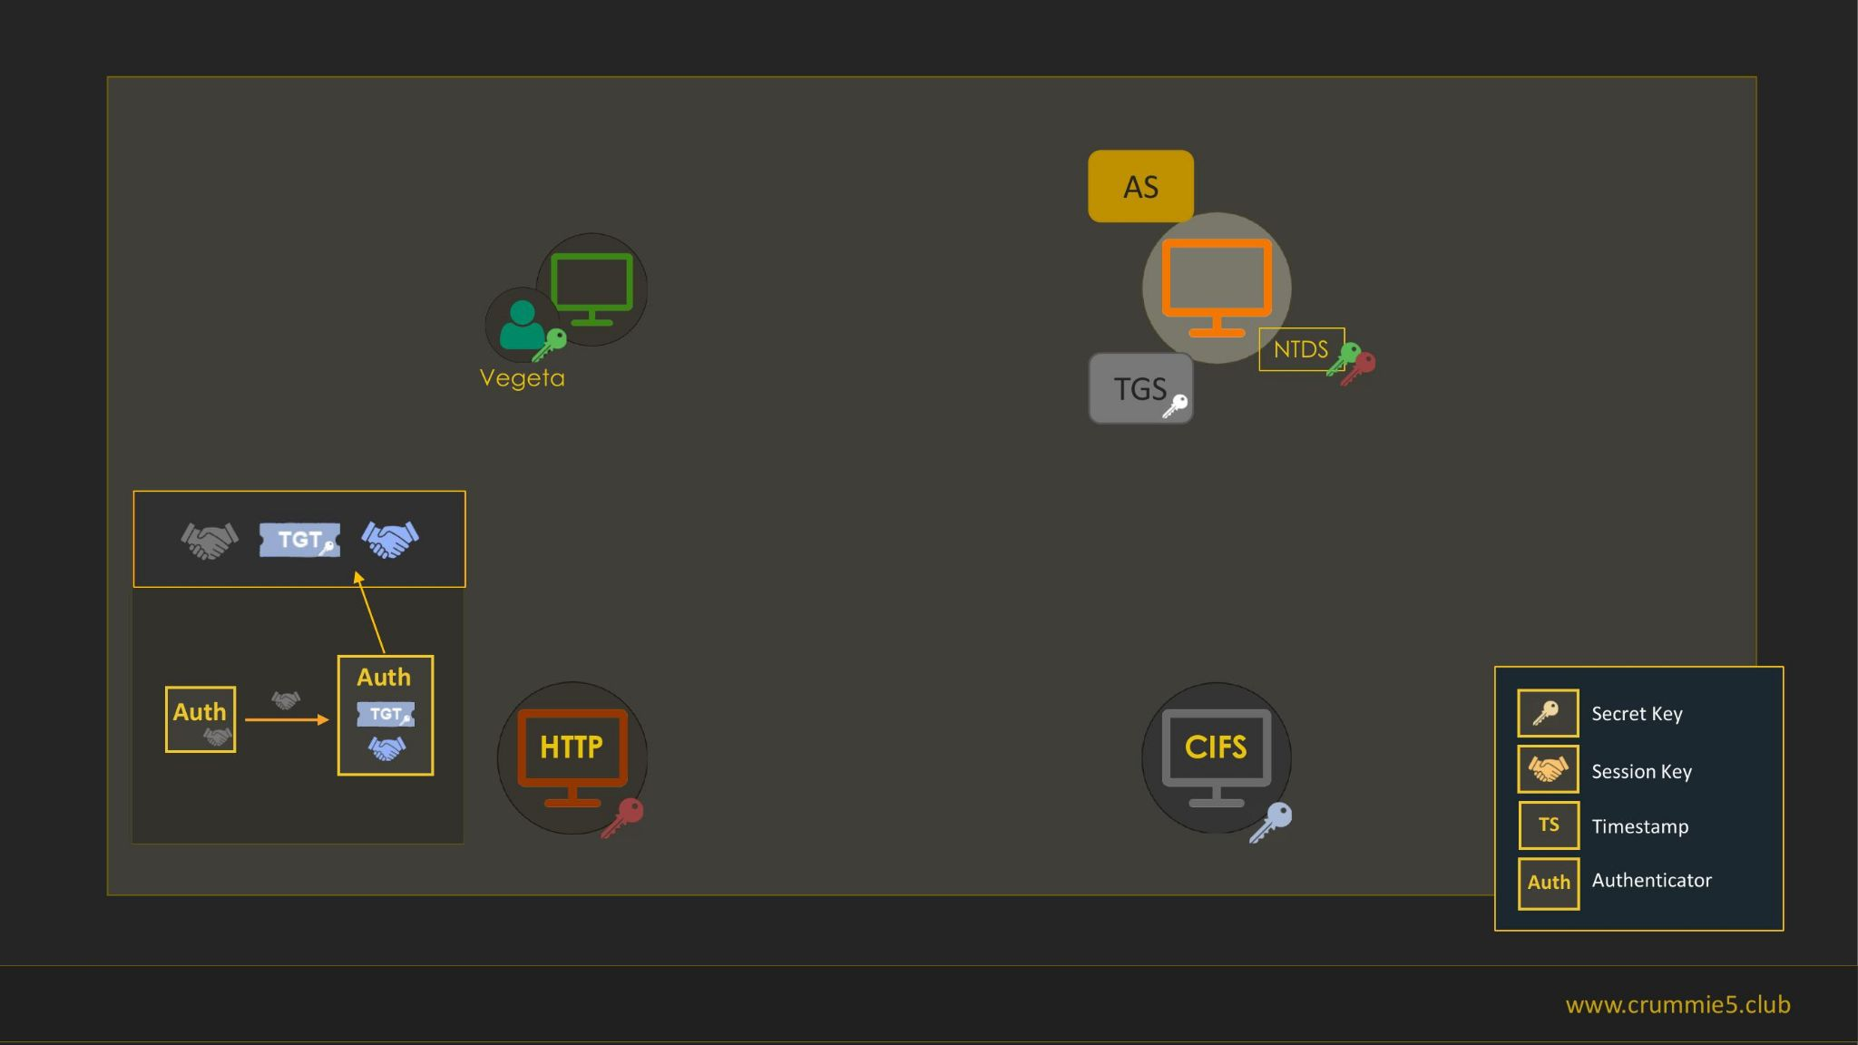

Slide 42
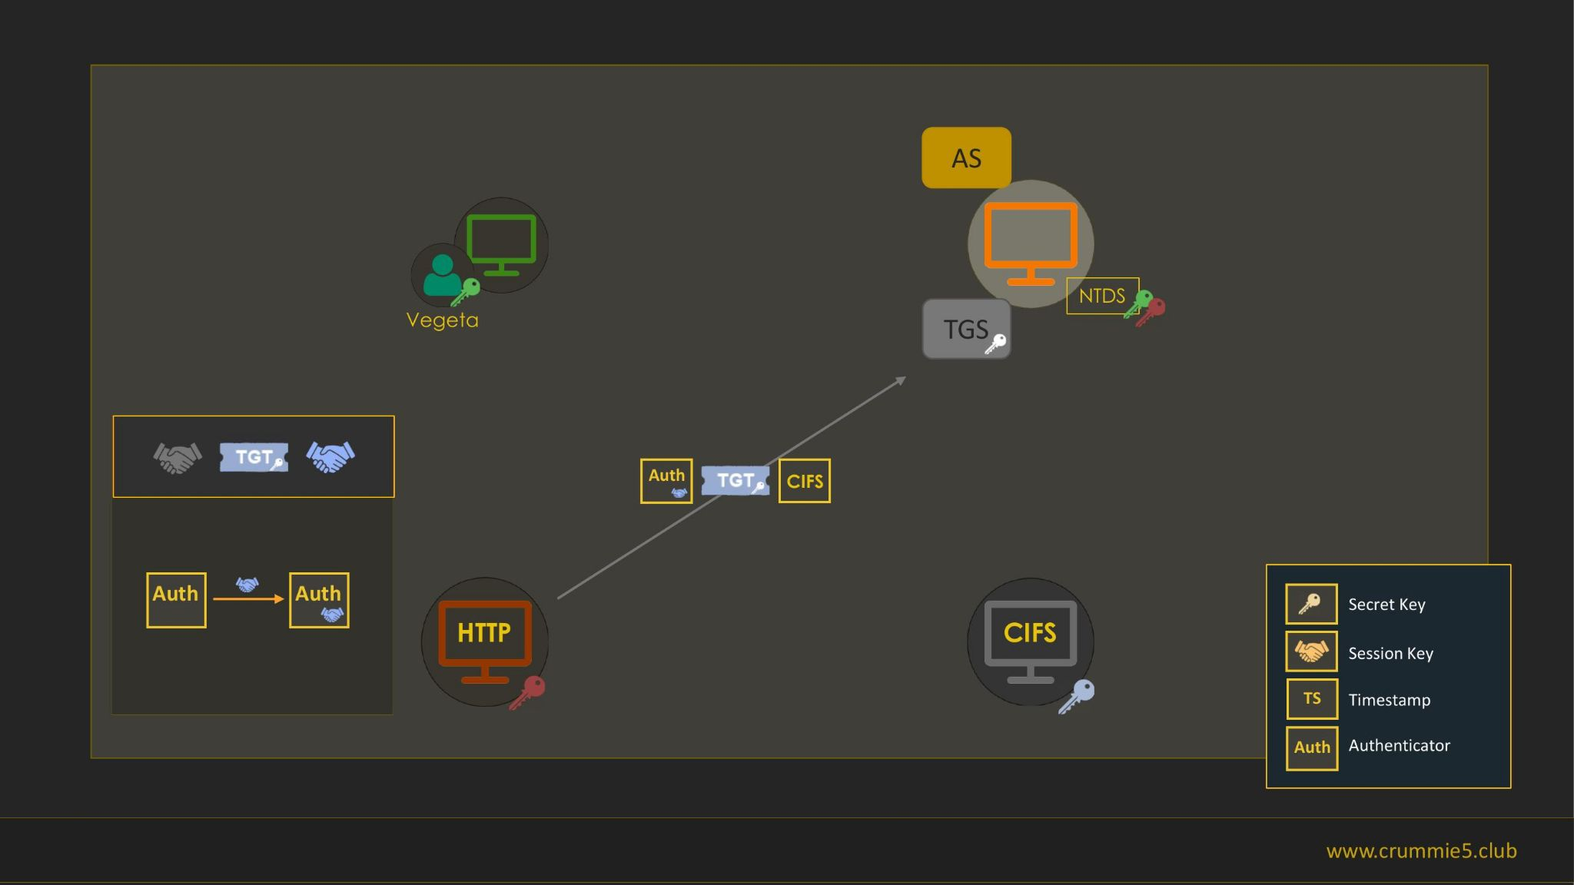

Slide 43
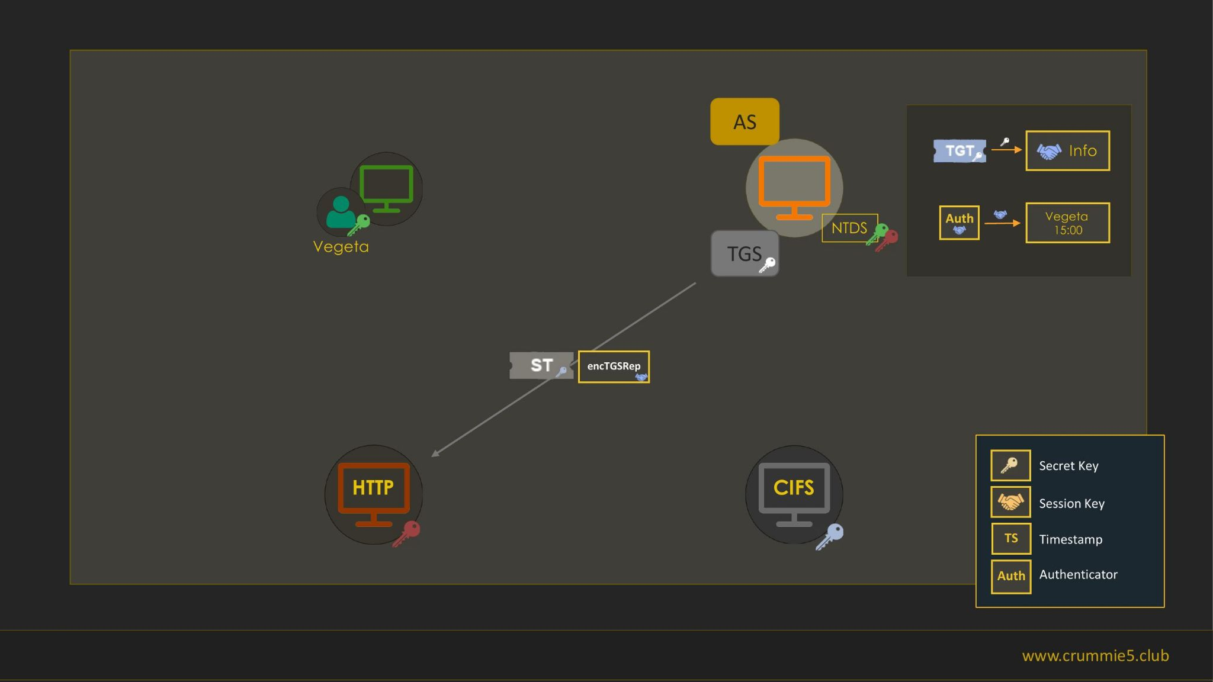

Slide 44
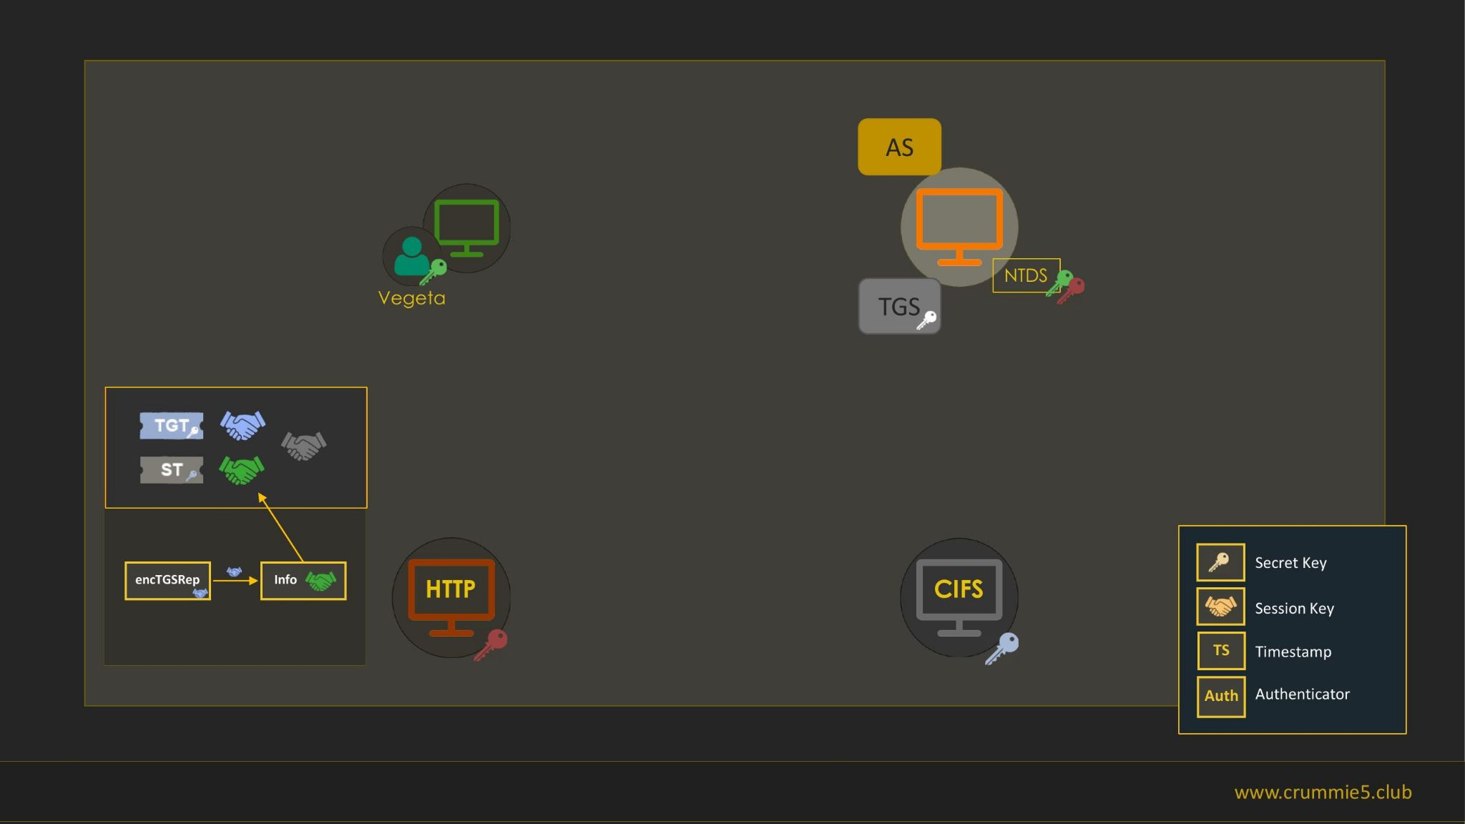

Slide 45
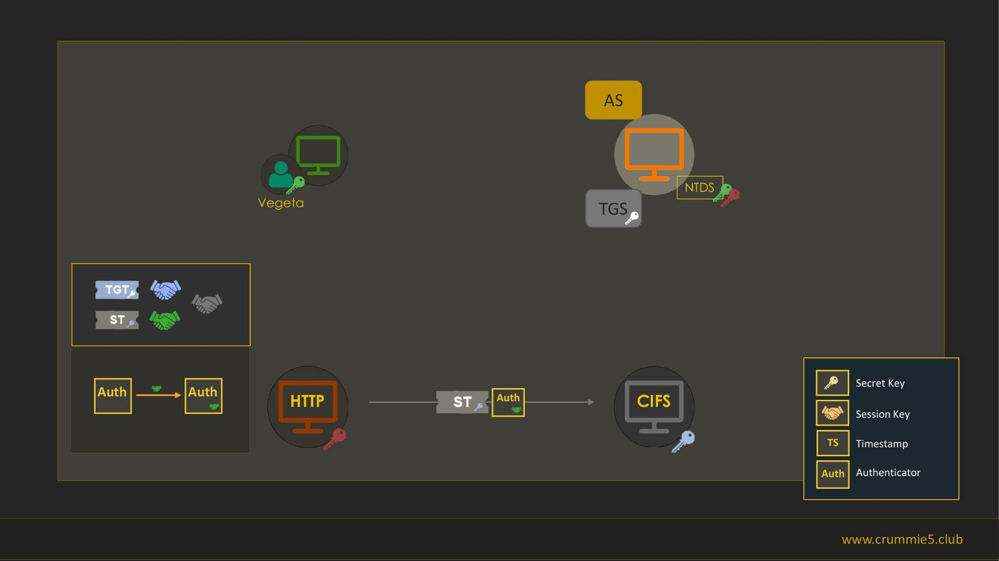

Slide 46
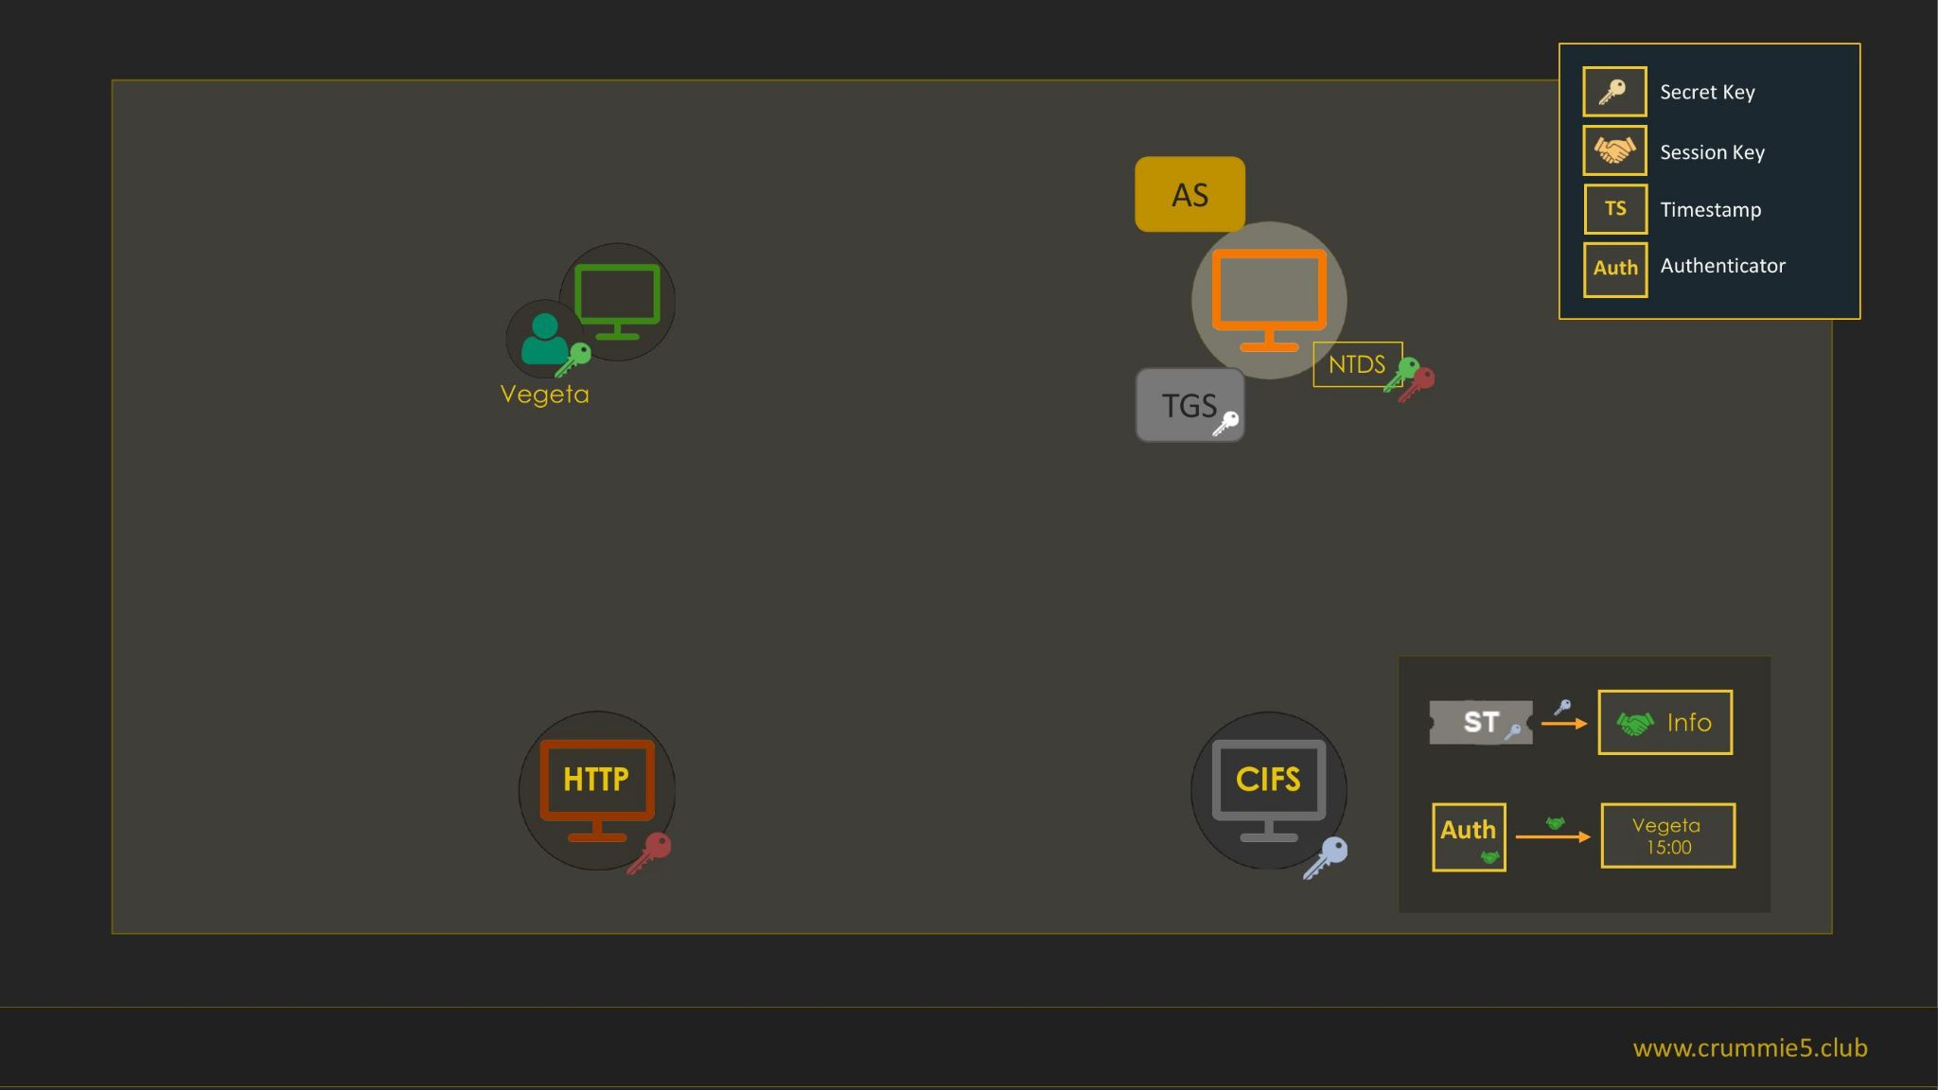

Slide 47
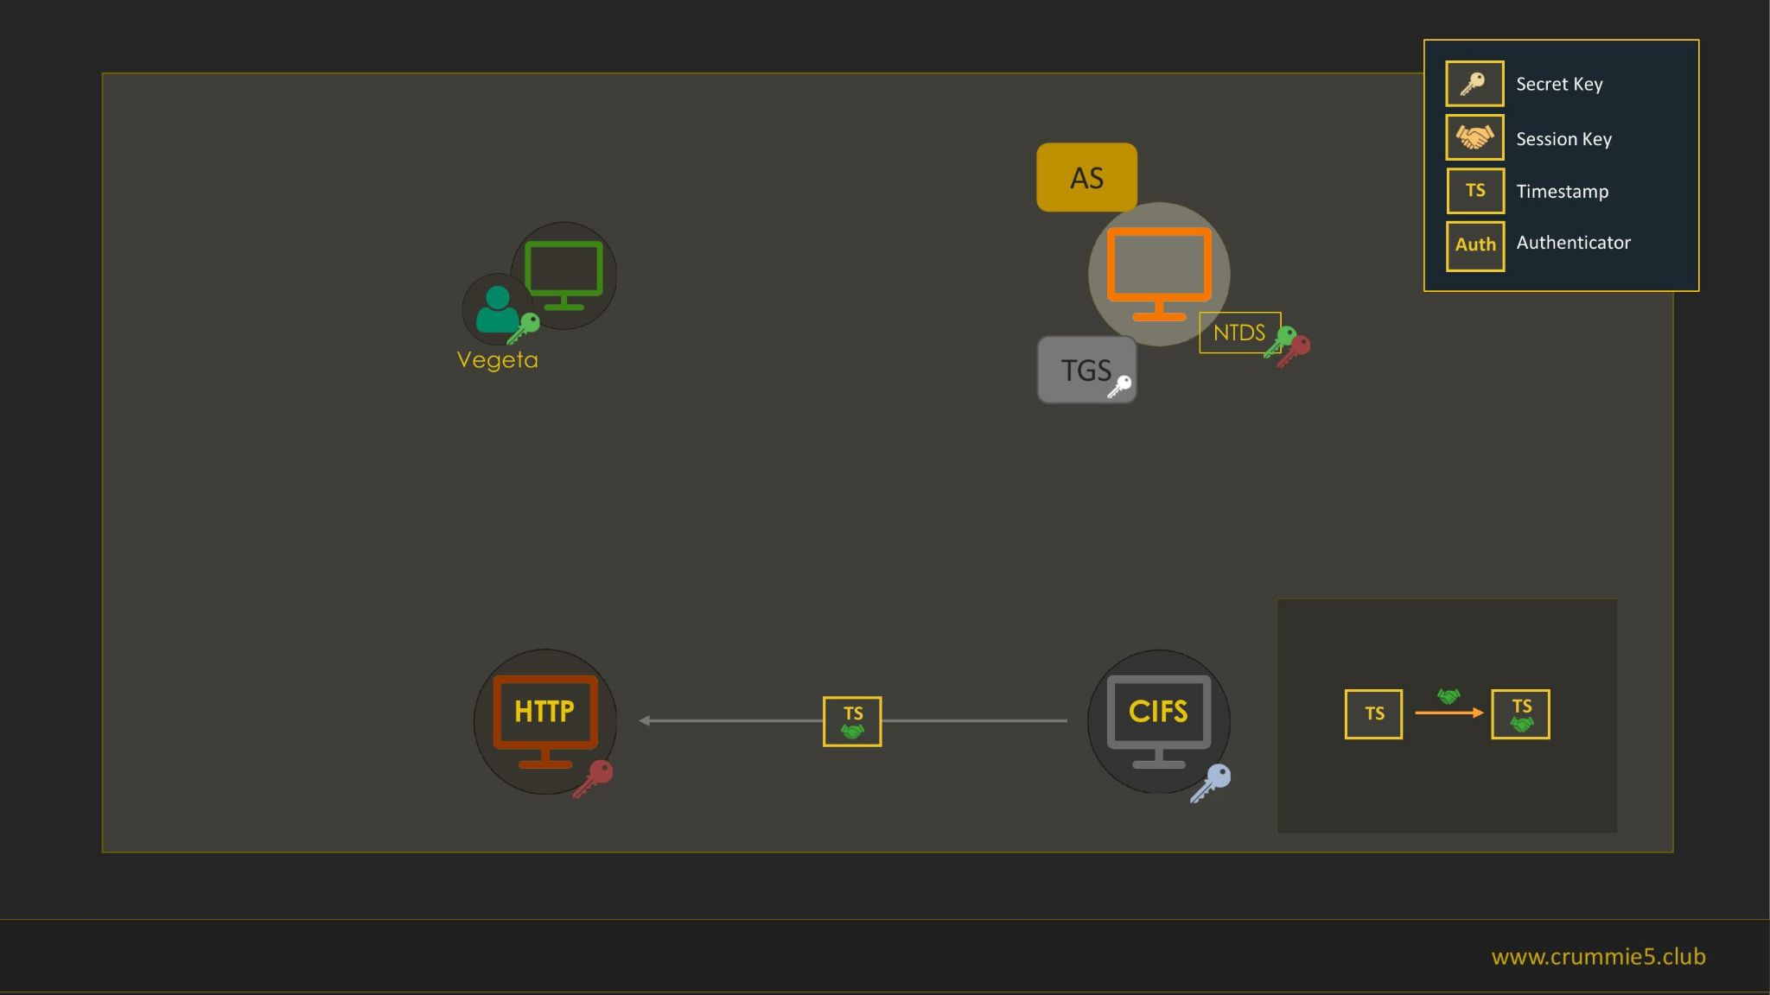

Slide 48
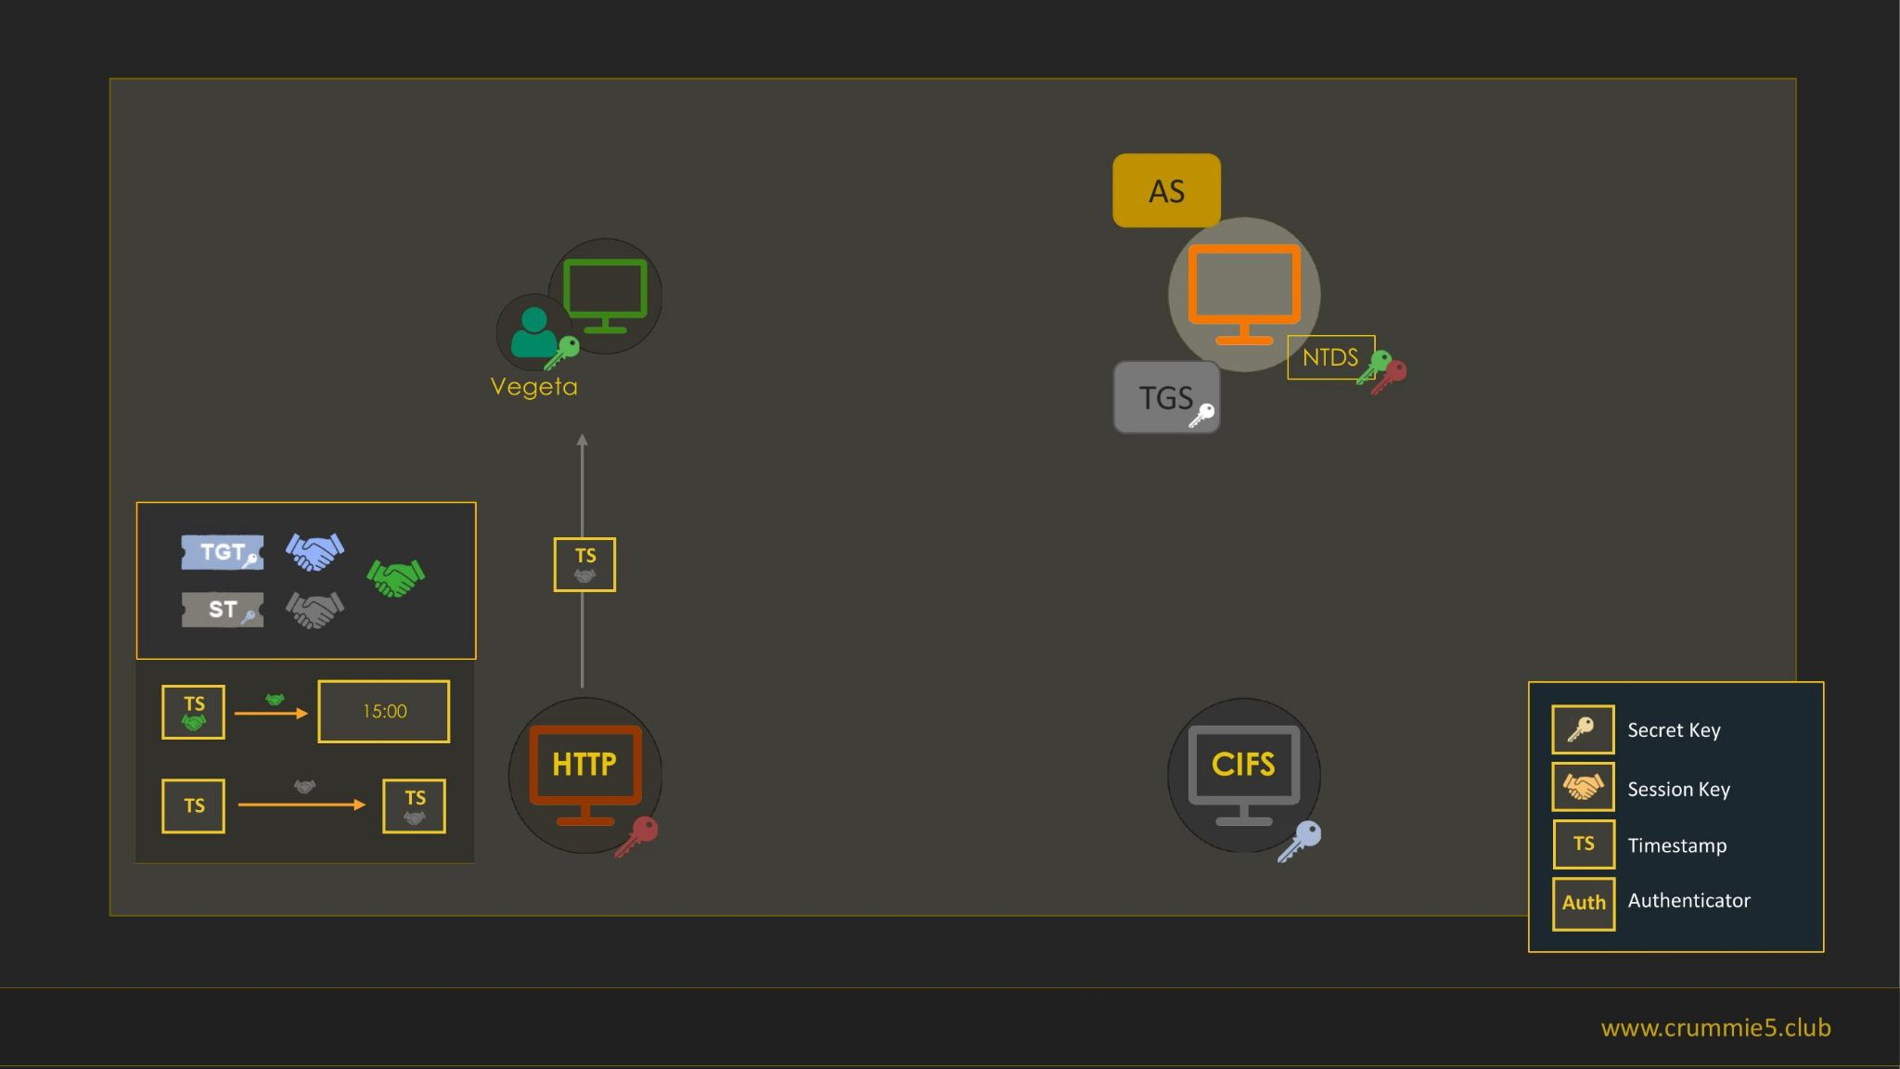

Slide 49
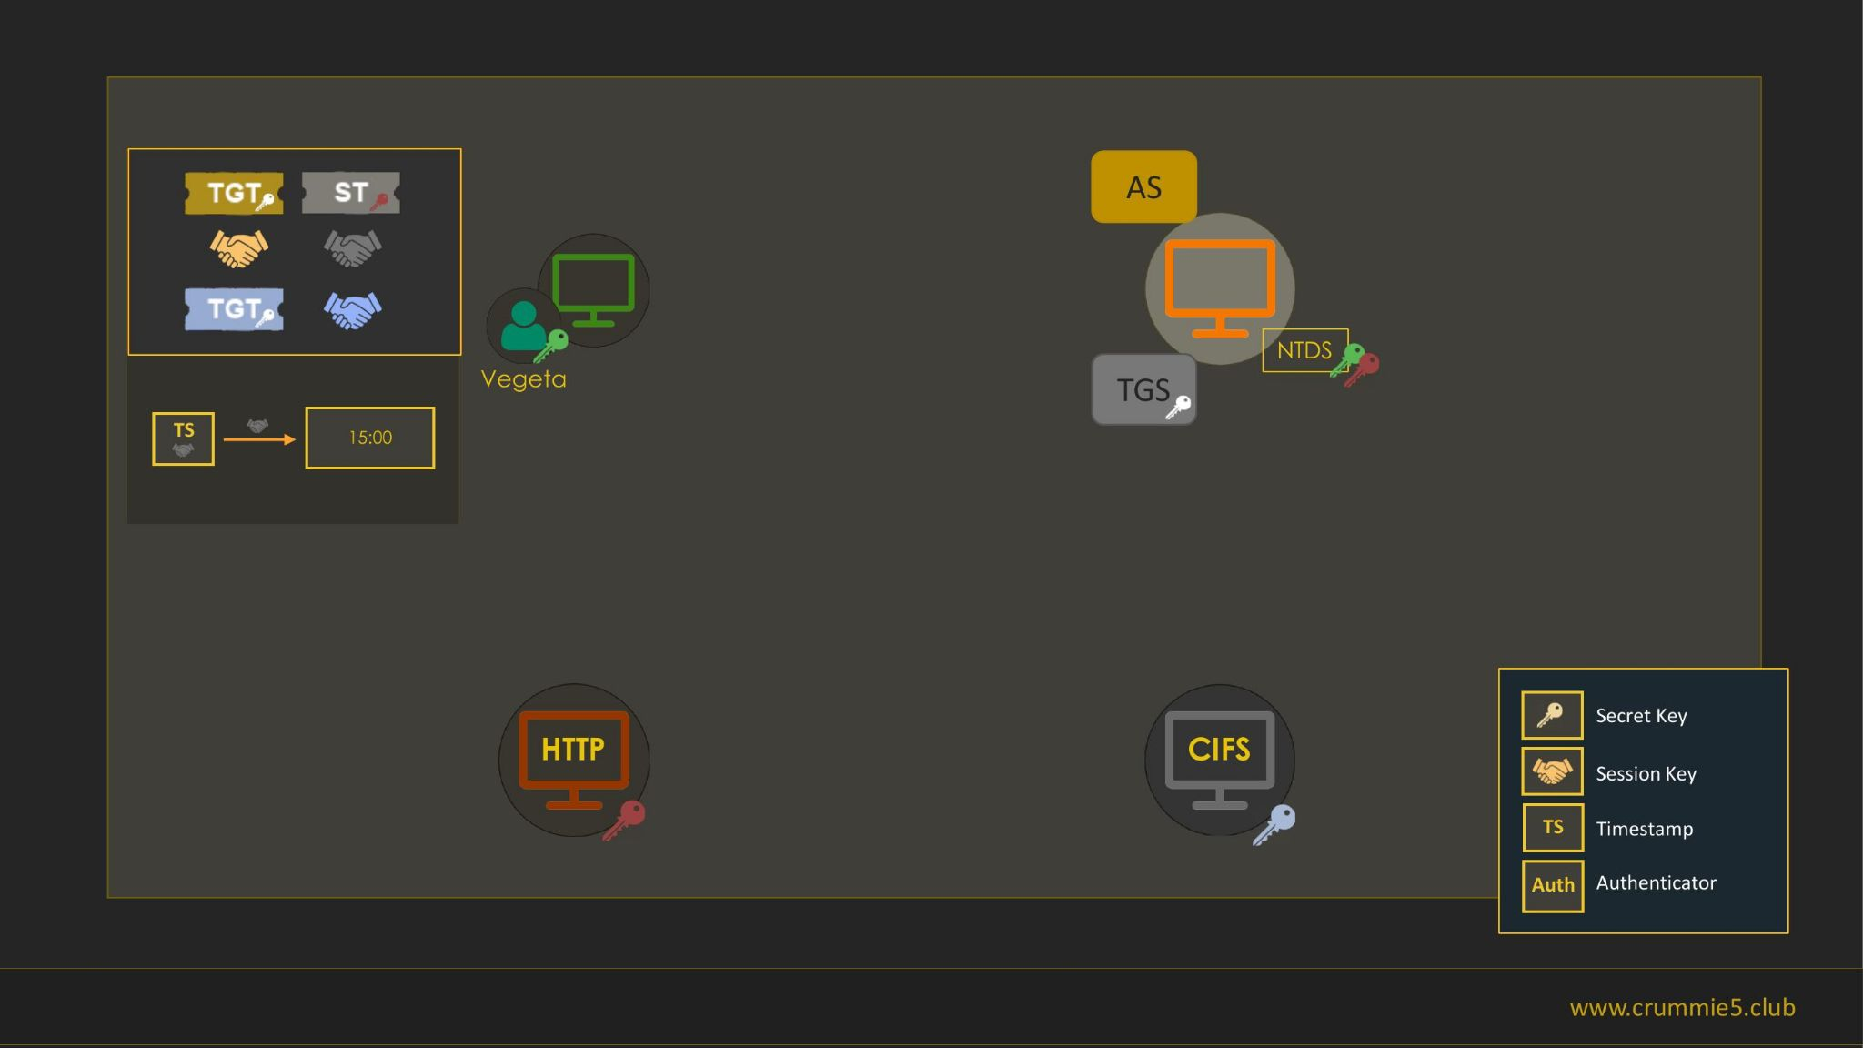

Slide 50
Unconstrained delegation abuse (1)
Who is the attacker in the scenario of an unconstrained delegation?
  User, by design
What if the attacker is in control of such a service?
  Impersonation of every authenticated user
What if the attacker can force entities to authenticate to the service?
  Privilege escalation :)
  RPC printer “bug” :)

Slide 51
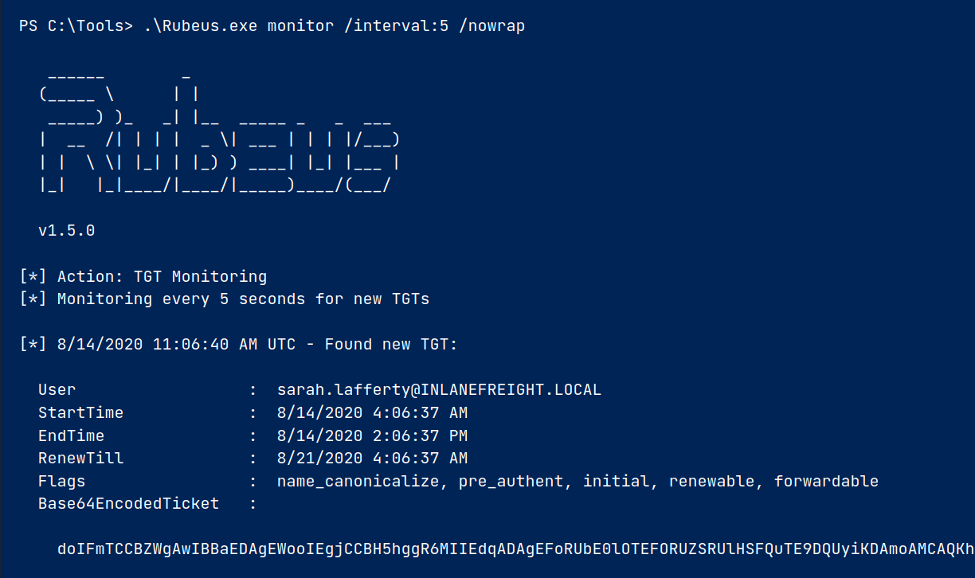
Unconstrained delegation abuse (2)

Slide 52
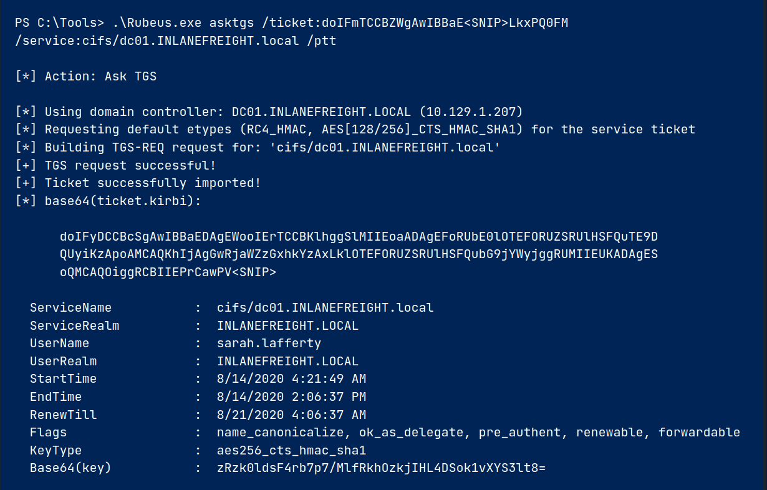
Unconstrained delegation abuse (3)

Slide 53
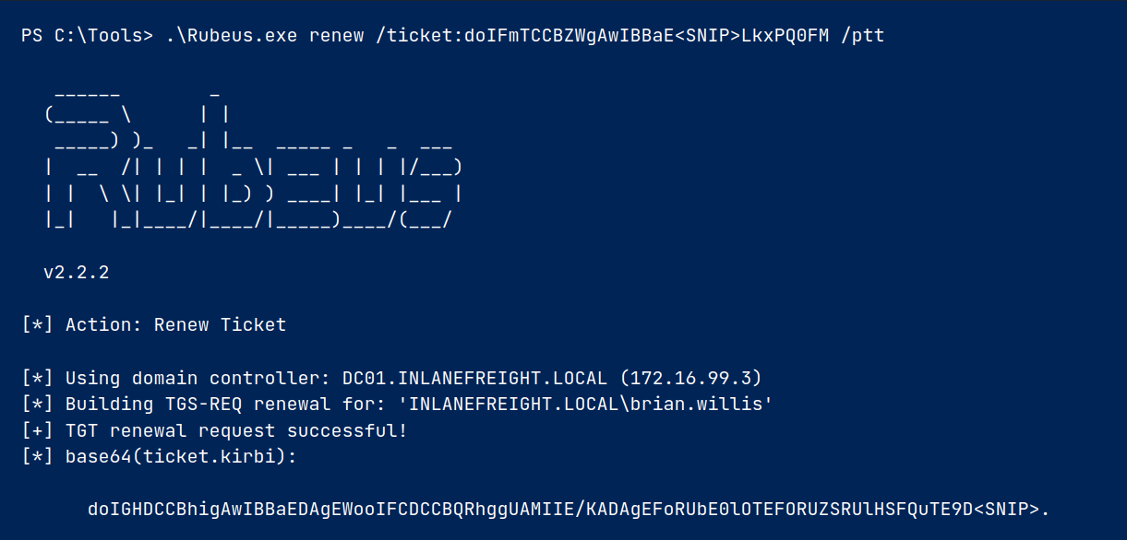
Unconstrained delegation abuse (4)

Slide 54
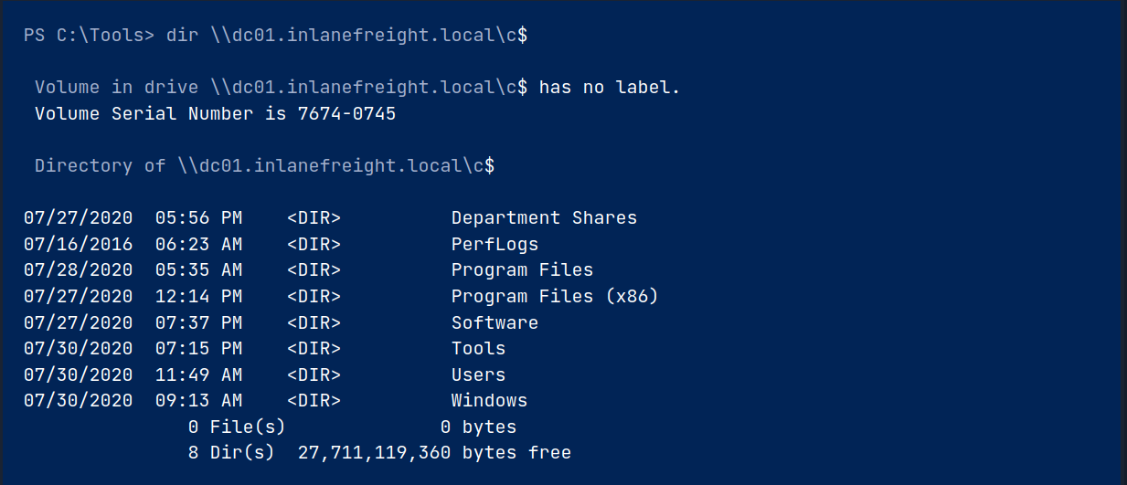
Unconstrained delegation abuse (5)

Slide 55
Reference 1
https://learn.microsoft.com/en-us/openspecs/windows_protocols/ms-kile/b7219d26-dbc7-4f3a-adfe-dcc31f90d92a (MS reference for used protocols)
https://www.rfc-editor.org/rfc/rfc4120 (Kerberos v5)
https://www.rfc-editor.org/rfc/rfc4757 (RC4 KDF)
https://www.rfc-editor.org/rfc/rfc3962 (AES KDF)
https://datatracker.ietf.org/doc/html/rfc3961 (AES KDF DK function)
Introduction to AD HTB module
Kerberos Attacks HTB module
Active Directory Enumeration & Attacks HTB module
https://vbscrub.com/2020/02/27/getting-passwords-from-kerberos-pre-authentication-packets/ (Sniffed tickets BF)

Slide 56
Reference 2
https://curl.se/rfc/ntlm.html (NTLM documentation)
https://learn.microsoft.com/en-us/windows-server/security/kerberos/ntlm-overview (Official NTLM documentation)
https://infosecwriteups.com/ntlm-authentication-in-active-directory-b99ea9087519 (NTLM in AD)
https://www.youtube.com/watch?v=xDFRUYv1-eU (Kerberos unconstrained delegation)

